Slide 1
MedCommons PFP SubSystem v4
Annotations, Comments and Outright Requirements
Hacks of old slides are in Pusia
Outright Deletions are Embossed

Slide 2
Things to Add
Discuss Removal of MySql – not needed for this
Discuss Removal of Tasks – quicksand
Discuss Forms Design Process
Discuss Required and Optional Form Fields
Discuss ‘Next Procedure’
Discuss Mapping of Users to Roles
Discuss Tasklist Filtering
Cleanup Naming Ambiguity
Discuss Document Types Supported

Slide 3
Deliverables
User Tasklist with Filters by Role, Time…
Form Filler (PFP) - Creates, Updates and Stores Records from Forms (Templates) and generates TODOs
Form Builder that Makes New Forms from scratch or from existing Forms
Signature Pop-UP for Signing Records and Forms as means of completing TODOs
Persistence via MySql, FileSystem, SVN
Move files from FileSystem or SVN to CFR archive

Slide 4
21 CFR-Part11 Archive
Completely self-contained snapshot of Records, Documents, and all QMS linkages. Packs in all Docs referenced in Records.
Includes XML Schemas and XSL and ??? to ensure Archive be reloaded 100 years from now. Docs may be in any format, but longevity of non-XML docs is indeterminate.
Utility will spool latest version from Subversion out to Archive on nightly basis. Hopefully this will fit on a DVD.

Slide 5
Process Forms Processor
PFP is invoked with URL of Form to Fill
  url usually comes from a hyperlink on webpage
  User fills in mandatory and optional fields
  PFP checks consistency and iterates with user until complete or abandoned
PFP adds RECORD in local SVN tree
  At some later point, PFP does SVN Commit
Is PFP a Web Service?

Slide 6
Worklist/Tasklists
Tasks are Just Records with Status that must be disposed of by Users in Roles
You can only get a task off the list by signing it – at which point the task is given to another User in a Role as determined by the ‘Next Procedure’ field in the record

Slide 7
Tasklist for J Bloggs, Chief System Guru, 5/20/04
Stat | Record | Pri | Entered | DropDead | Comments
¥ | Approve Design of new CoLo |  | 5/17/04 | 5/22/04 | Free form with links
 | MySQL Perf Review |  | 5/14/04 | 5/23/04 | Extracted from the Record
 | Attend Mgmt Review |  | 5/18/04 | 5/20/05
 | Install new SVN release |  | 5/20/04

Slide 8
Process (Role) Worklists
?User Tasklists?
Tasklist is a better name as it is consistent with Eclipse and not confued with Modality Worklists
Filters can be established via UI to determine what’s in a particular tasklist
  The filtering mechanism will get fancier in subsequent revisions, but must include a basic filter by role and priority
View in Web Browser or Eclipse
  If web form then would be invoked by type as separate editor from eclipse.
Automatically Updated by Process Forms Processor
  When the PFP pushes new data into task table, the worklist viewer must update itself. For a first cut, an autorefresh page would be ok
Administrative intervention managed through Exception Forms
  There are 2 ways to get something to change status in the Tasktable
    Do the task and SIGN IT (different types of signatures for different states)
    Some special forms have embedded abiity to change task status, and they temselves will need to be SIGNED to be executed

Slide 9
Records
Records are just filled in or partially filled in Forms that have been signed
Even a partially filled in form is signed as the mechanism to push the record onto the next step a record
Any links to other files in the Record that are marked as mandatory should be auditable in real-time, to verify existence
Records have mandatory fields and a variable body.
Normally, the body consists of a collection of URLs as pointers to files, and descriptive fields in HTML
The display of a record is via an XSL stylesheet

Slide 10
Product Code Submission Record
Form #: FORM QA EML 3 852 12 01
Record # : RECORD ZZ 3 432 42 X
Description: Check In 3D Slicer Math Routines Ver 3.2B
Component | Requirement Spec. | Design Spec. | Test Spec. | Test Result | Traceability Matrix Reference
Arctan.java | InverseTrigSpec | …
Slicer3d.java
Next Procedure: Test3d
Name Title Role Date__________
SEAN DOYLE CMO SWEngineer January 12, 2004
Signed: JK83H320SX34NDIMWIK27

Slide 11
Record Signing
Allows flexible signing plug-ins, including no signing at all
For the first cut, uses USPS system via JAVA SDK
  The base documents will be signed separately via USPS plugins
  Ultimately we may not want to pay for minor records to be signed via USPS scheme, so multiple schemes should be allowed for different form types
All signings separately logged
Can not complete “task” until the user ‘signs’ that it is done sign record until all conditions are ‘satisfied’
  This means checking that all files referenced in the record actually exist
  When displaying a record, any files that don’t (yet) exist are displayed in yellow

Slide 12
Forms
Forms are Just Templates
There is a Form Designer that Makes and Edits Forms
Forms must be signed by their creator
Templates can be XML schemas and XSL
The Form Designer may just be normal XML based editors and tools
Forms may be partially filled and stored as other Forms even by naïve users who are not XML savy
From the perspective of signing, forms are just records.

Slide 13
Product Code Submission Form
Document #: FORM QA EML 3 852 12 01
Doc. Title: Product Code Submission Form
Description: This is a typical controlled code submission
Component | Requirement Spec. | Design Spec. | Test Spec. | Test Result | Traceability Matrix Reference | Notes
URL | URL | URL | URL | URL | URL | html
Name Title Role Date__________
Adrian Gropper CMO Prod. Mgr. January 12, 2004
Signed: JK83H320SX34NDIMWIK27

Slide 14
Product Code Submission Form B
Document #: FORM QA EML 3 852 12 02
Doc. Title: Alternate Product Code Submission Form
Description: This is a typical controlled code submission
Requirements_spec = URL
Test_spec =* URL
Name Title Role Date__________
Adrian Gropper CMO Prod. Mgr. January 12, 2004
Signed: JK83H320SX34NDIMWIK27

Slide 15
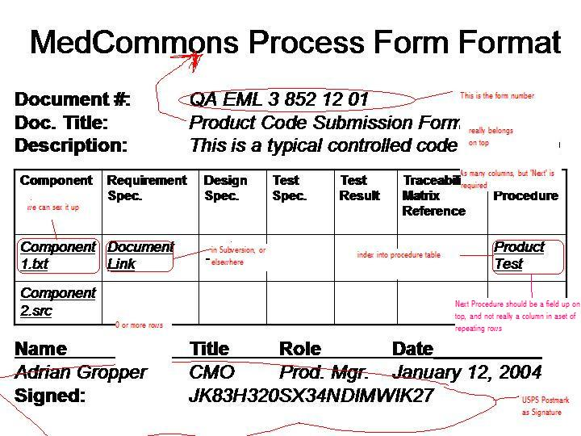

Slide 16
Process Forms Processor
User Navigates and Selects Form to fill from Tree
  Form is Presented to User as a ‘ Record’ for fill-in
Enforces Syntax of mandatory fields and referential integrity of links
  Presupposes that all referenced files must actually exist.
Automatically Pack and Save context to 21 CFR-11 Archive
  Shouldn’t it say content?
  Need to discuss representation of the records on disk and whether data and/or metadata in real database
  The Archive is NOT Subversion
Add / Remove items from Process (Role) Worklists
  There is data that can be entered into a form or a record, which when interpreted by the PFP causes the record to be placed on one or more worklists/tasklists when it is ‘completed/signed’ by the form filler
  The ‘Next Procedure’ Field serves as in index into a business rule which specifies which ‘Roles’ need to deal with this record, possibly multiple
  At any point in time each Role has one or more real people assigned who can fulfill this role

Slide 17
Meta-Process Description
A Document is complete, finalized, and signed.
The Record of the context for that document is satisfied and signed.
An Entry is removed from a Task List.
An Entry is added to another Task List.
When all is steady-state the Task Lists do not overflow. At least one Meeting periodically reviews the number and nature of tasks on all Task Lists and suggests improvements to the Quality Manual.
The improvements result in changes to Documents and to Forms that will become Records.
The cycle is complete.

Slide 18
Task Lists
The primary purpose of Task Lists is monitoring (not control).
The Master Task List has all of the entries corresponding to signed Records along with information that can be used to filter the list during management meetings.

Slide 19
Quality System Essentials
Policies
  Quality Manual
  Roles and Resp’s
Documents
  Design Input
  Requirements
  Engineering
  Test Spec
  User
  Marketing
Records
  Training
  Customer Support
  Installation
  Test Results
  Inspections
Meetings
  Risk Analysis
  Design Review
  CAPA Review

Slide 20
First Generation Projects impacted by PFP Development ♪
Development and Support Tools
Quality System and Process Tools
Router Main UI Screen
DICOM Import / Storage / Export
Reference Hardware System
Authentication
Central Installation, Control and Support
Central Account and Log Access
21CFR11 Archive
Supported Viewers

